Slide 1

Distributed Web Crawlers on AWS for Sentiment Analysis using EMR.
Vineet Bharot
Aditya Basak
Mohammed Farhaan Parvez

Slide 2
Introduction
We aim to develop a distributed system of scalable web crawling solution which searches the internet for specific keyword guided information and saves it in a persistent storage which can be processed later.
Our system should be able to scale in order to fulfill the need of either the web crawling or data processing pipelines.
We are using this data for real-time sentiment analysis. It gives you a window into what the masses are expressing about the topic “right now”. It provides for a targeted, minute-by-minute analysis which is useful for feedbacks, campaign success analysis and market predictions.

Slide 3
Application Specifications
Designed an efficient data fetching and processing pipeline which can scale according to the requirements.
Overcame Twitter API scraping limitation.
System designed to incrementally improve, with no downtime, upon the sentiment analysis of past data, when new data better implemented in our sentiment analysis microservice is available.
Developed using AWS cloud solutions.
Used Map-Reduce via Amazon EMR to facilitate concurrent processing of crawled input data by multiple applications.
Facilitates Rapid Code Development, integration and deployment of CI/CD pipeline.

Slide 4
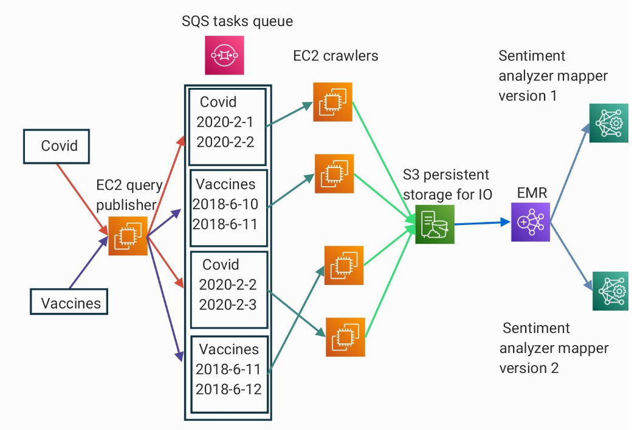
Architecture of the Cloud System
Notes:
AWS EC2:
query distributor and publisher
AWS SQS:
used as the tasks queuing
AWS EC2:
Scrapers running TweetScraper
AWS s3:
as the persistent Storage
AWS EMR:
For running our sentiment analysis application via streaming mappers.
AWS CodeDeploy:
as git integrated code deploy CI/CD .

Slide 5
Specifics of Implementation
TweetScraper: Scrapped Twitter as it is the best source of Sentiment Analysis. Modified the fork on jonbakerfish/TweetScraper build using Scrapy because:
Scraping through Twitter API is very rate limiting. With Scrapy we can scrape if we don’t violate crawler's politeness policy.
We can not scrape and search past 7 days for any topic. Scraping the explore page with full support for queries with timestamp we can also overcome this limitation.
Other alternatives are blocked by Twitter and are no longer supported.
Scrapy: A working knowledge of Scrapy is a must as this is the framework on which the TweetScraper is built. We modified the code to suit our project needs.
BOTO3: Boto3 Library is required to interact with the AWS systems and subsystems like S3, SQS and EMR via a Python environment.
AWS CodeDeploy: Required in order to rapidly develop and deploy our whole solution a GIT integrated CodeDeploy CI/CD pipeline.
EMR: We use Amazon EMR to facilitate concurrent processing of tweet sentiment classification.
NLTK: A Naive Bayes Binary Classifier model was trained with the help of NLTK library and stored in pickle file. It classifies input string into positive and negative sentiments. The pickle file is uploaded to S3 to be used for classification in our cloud system.

Slide 6
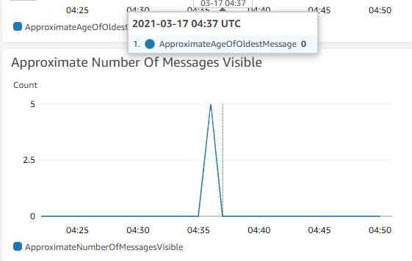
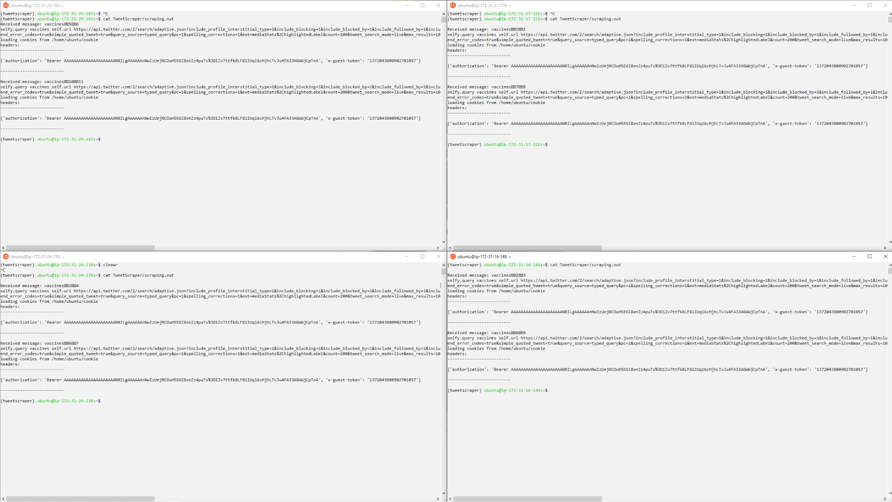
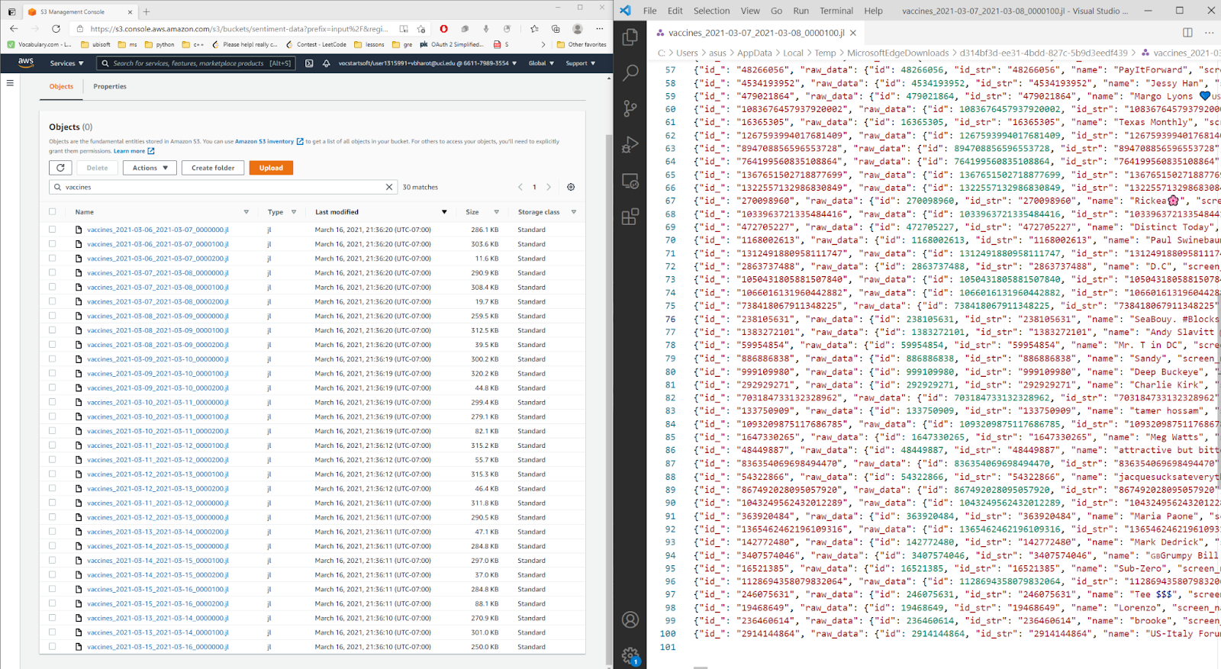
Testing and Evaluation
We were able to scrape 30 files each containing approximately 100 tweets in 2 minutes. Thus, we were able to scrape 25 tweets per seconds, which turns out to be 22500 tweets per 15 minutes which is 25% above the allowed twitter API scraping search limit of 18000 tweets per 15 minutes. Furthermore, as our solution is a scalable solution independent of the Twitter APIs, we can greatly improve the performance and scalability by adding more EC2 instances.

Slide 7
Thank You!
We would be glad to answer any questions!

